Slide 1

Sig website Project definition
SnapPapers Team:
Ramsha Naeem
Harsh Sanjaykumar Pandya
Alejandro Santoscoy Rivero
Sithija Wijesinghe

Slide 2
Problem statement
Engineering & Humanities SIG members are facing a huge learning curve using the SIG website due to the lack of collaboration promotion and the difficult access of their own papers.
We have observed that there are not too many SIG members at the website and the actual website capabilities are confusing.
If this problem continues, we are not expecting a notable growing rate of collaborations with SIG members from the public users. So, the users will not be able to find the related work or profiles of the Engineering & Humanities SIG members.
Therefore, we need to take a dynamic approach by promoting the integrity of the SIG council increasing the research papers accessibility and promoting collaboration with likeminded individuals in based on interests and/or geographical location.
To test our hypothesis, we are redesigning the SIG website focusing on the integration, innovation, inclusion and respect for the SIG members.

Slide 3
Features
Profile
Create
Update
Basic information, profile picture, and other artifacts.
Add/modify interests
Unlink/link papers manually (if automated system malfunctions)
Delete
Homepage
About us
Vision, Mission, Goals
Research papers
Automated linking
Search and filters
Networking
Looking for likeminded individuals
Search and filters
Chat
Promoting collaboration
Interest based
Geographical location based
Visualizations
Geaography based
Interest based
Research paper based
Trends in domains based on different statistics
Accesibility
Bilingual

Slide 4
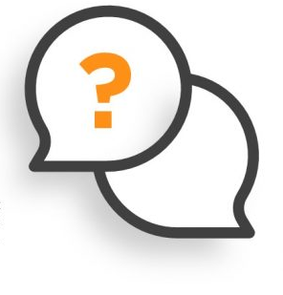


Questions & Answers

Slide 5
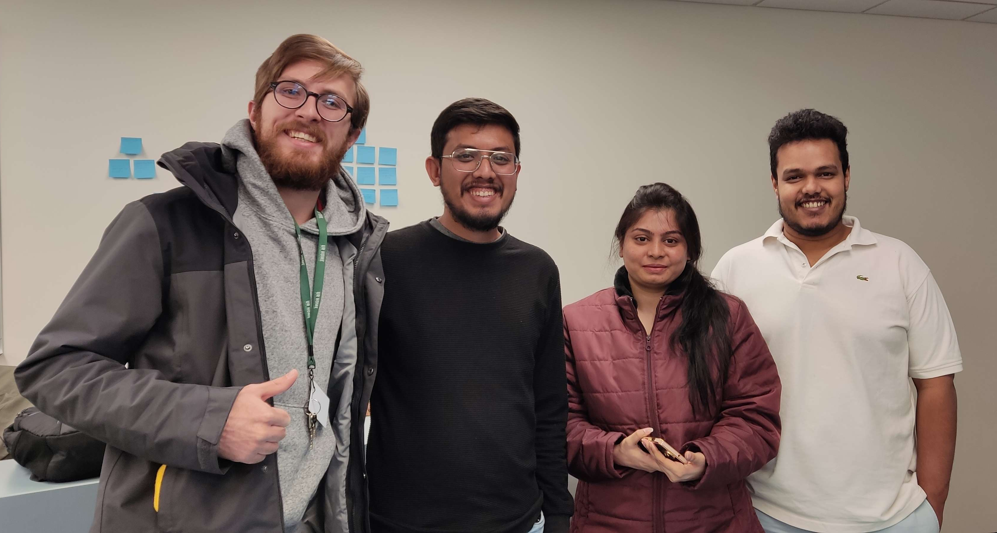
Thank you very much!
SnapPapers

Slide 6
User empathy map

Slide 7
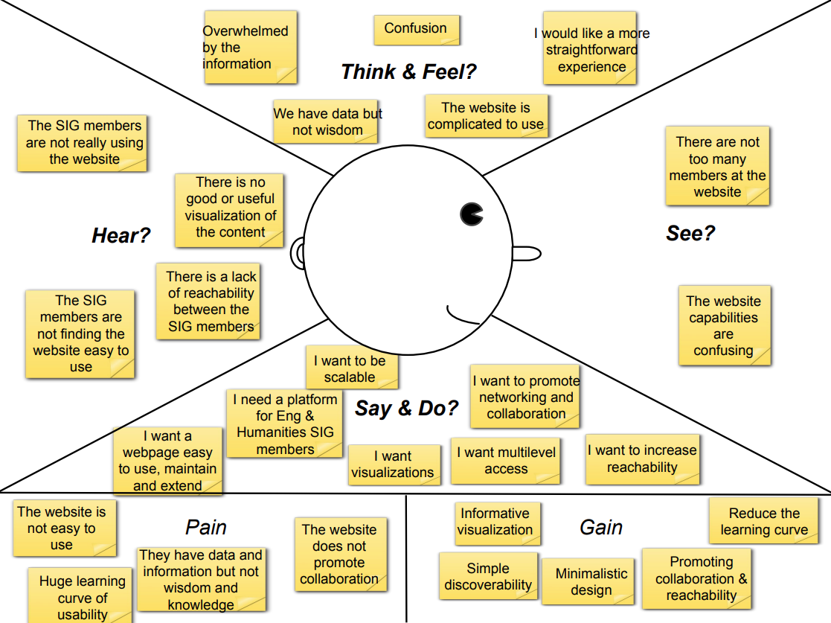

Slide 8
Affinity diagram

Slide 9
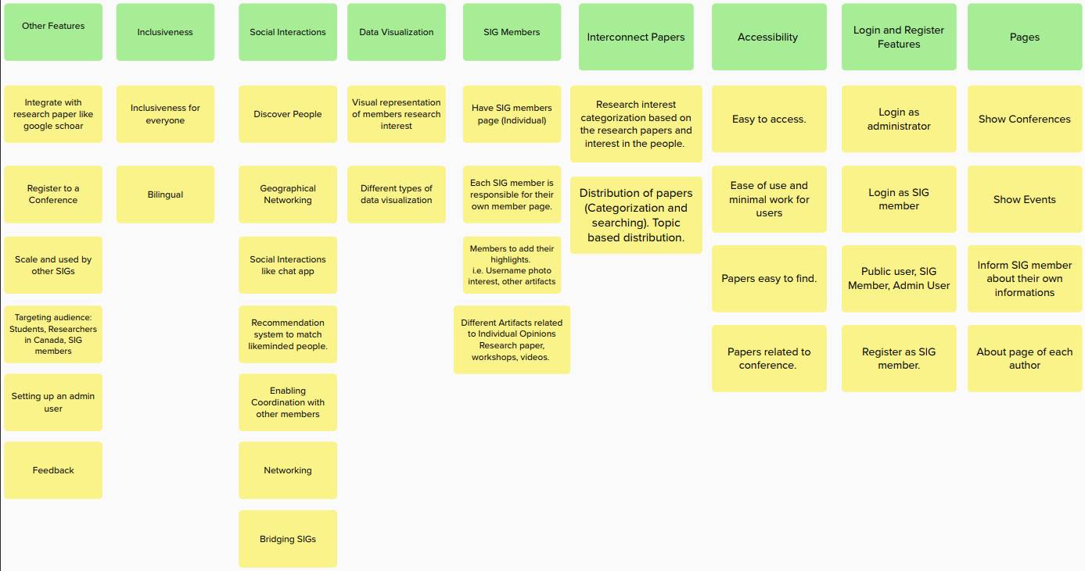

Slide 10
User story map

Slide 11
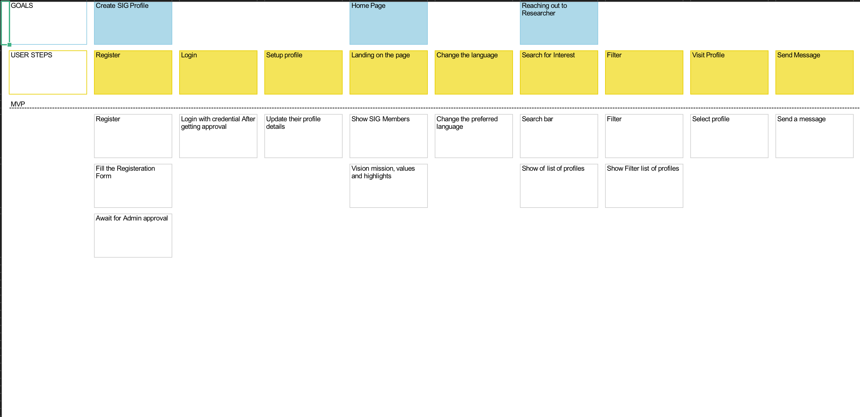
User story map (1/3)

Slide 12
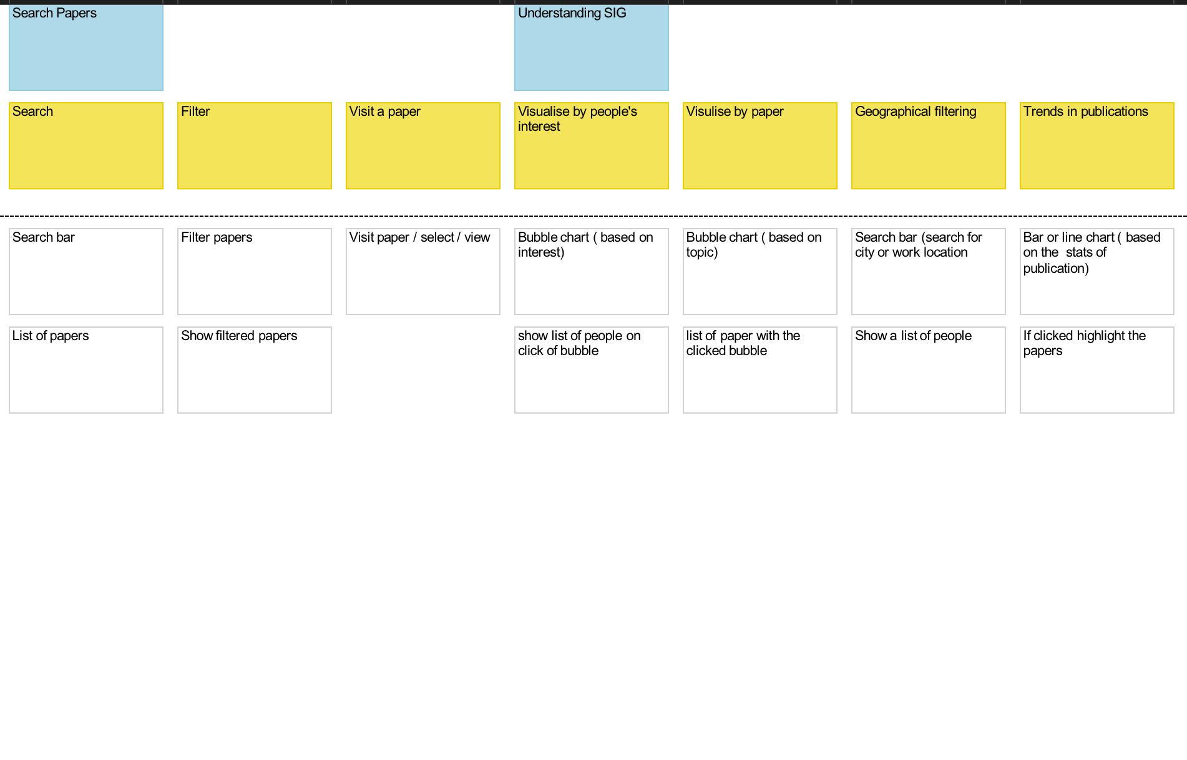
User story map (2/3)

Slide 13
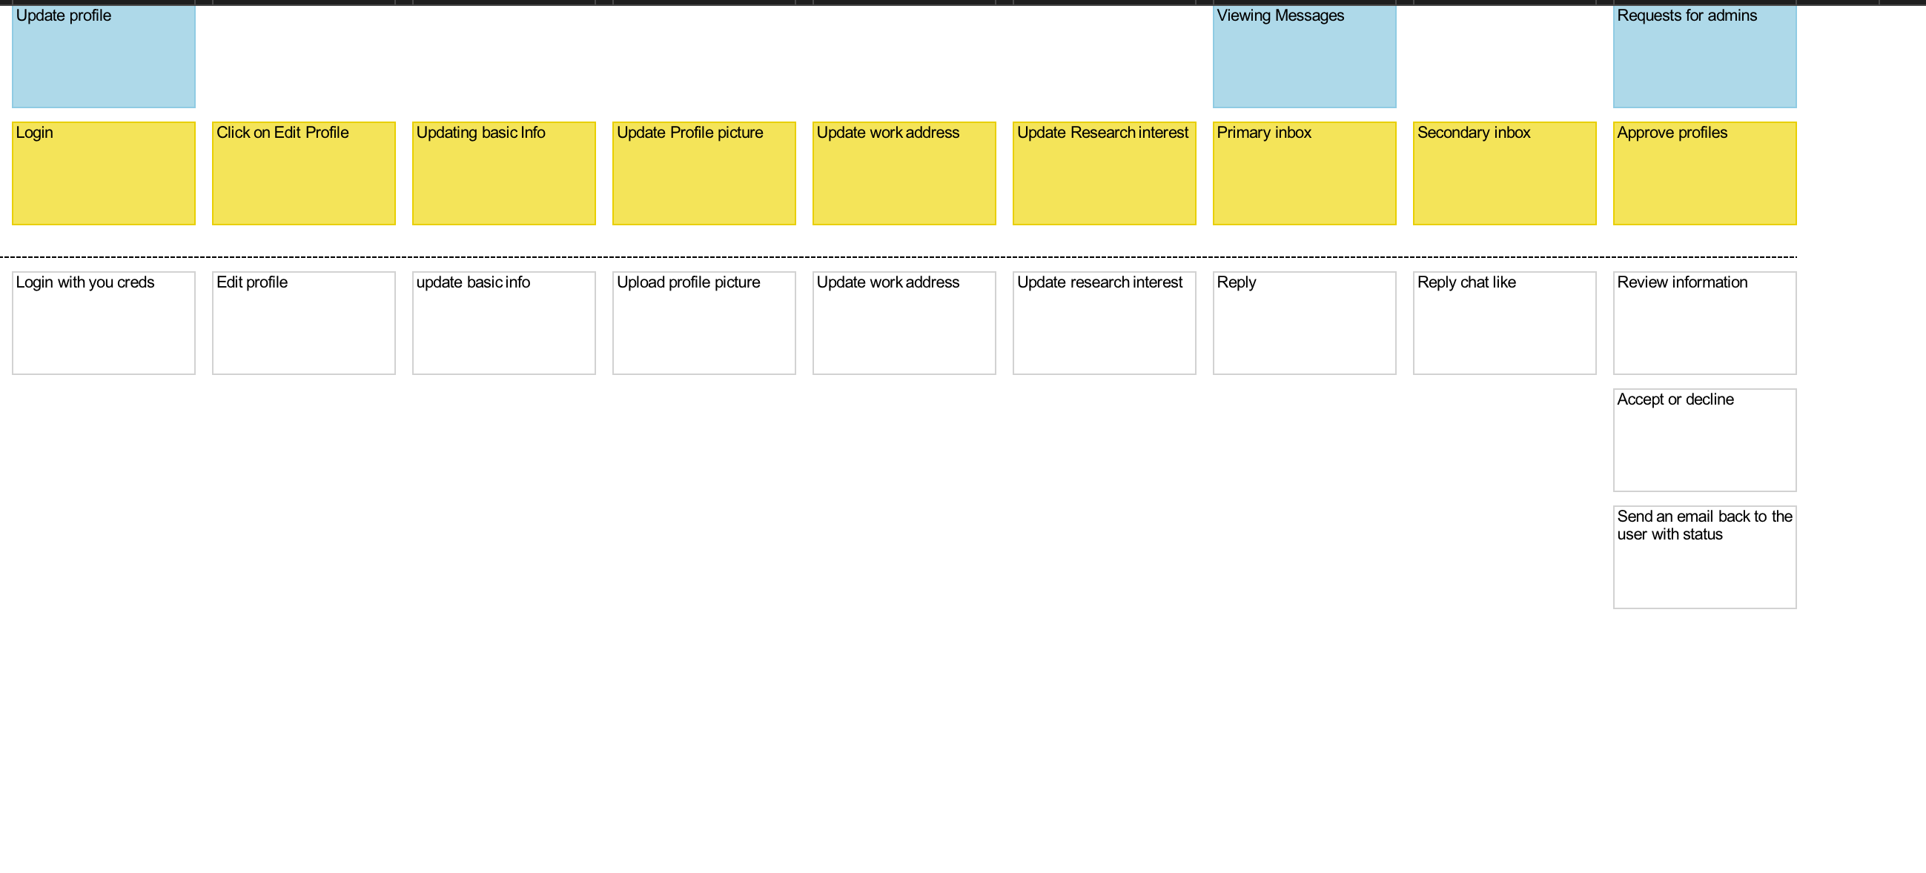
User story map (3/3)

Slide 14
Thank you very much!
SnapPapers

